Slide 1
Eng Computation
& Data Science

Slide 2
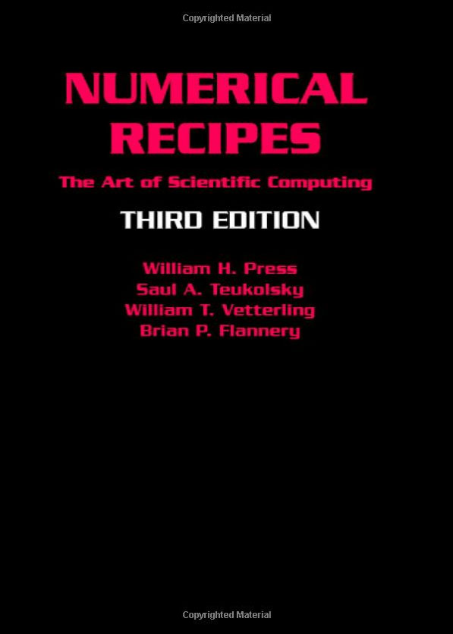
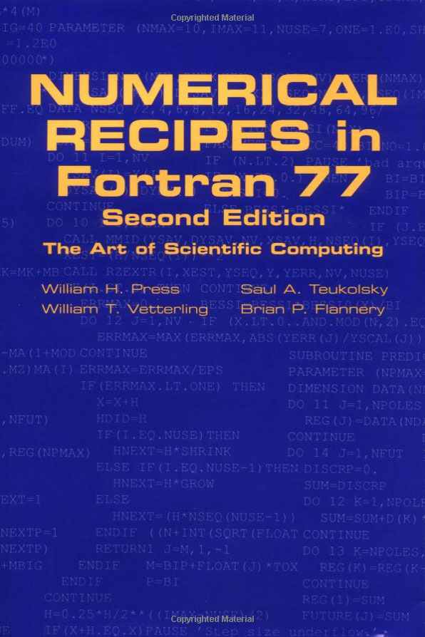
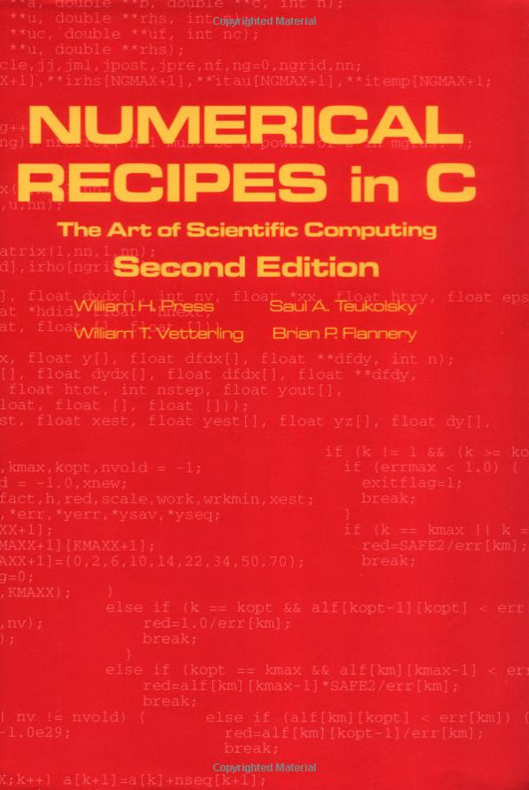
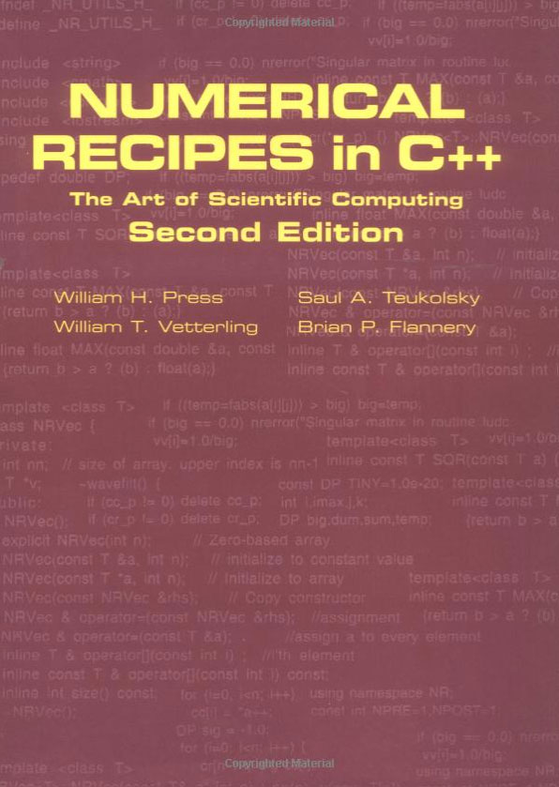
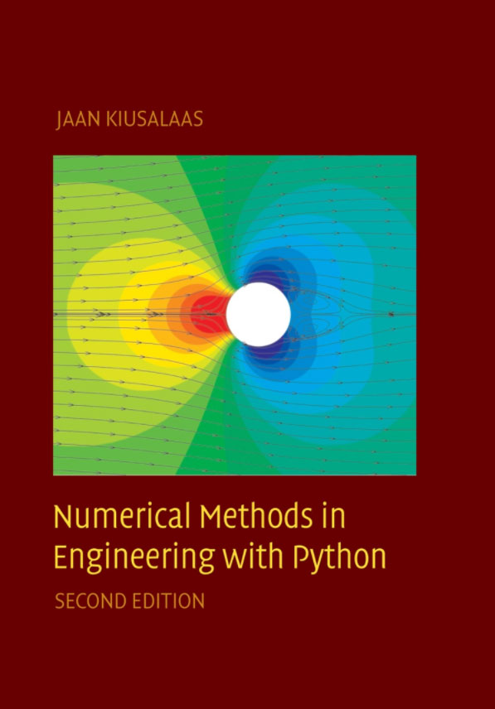
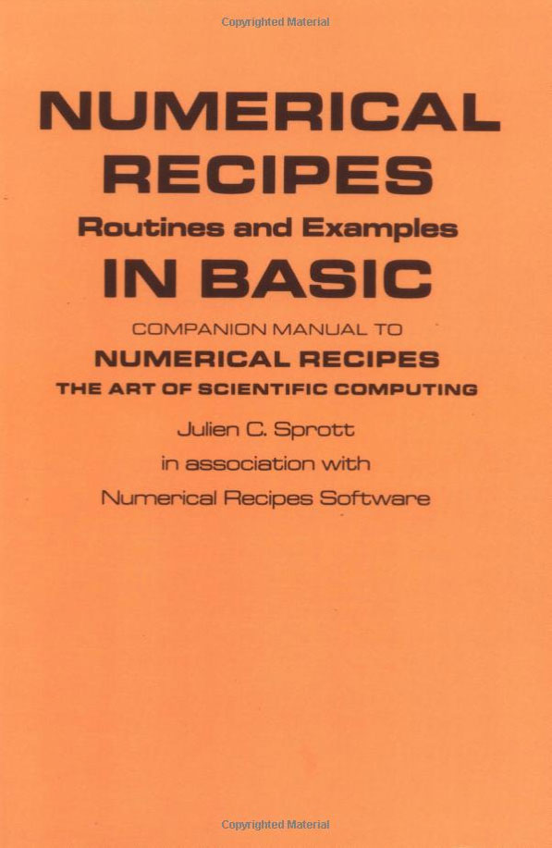
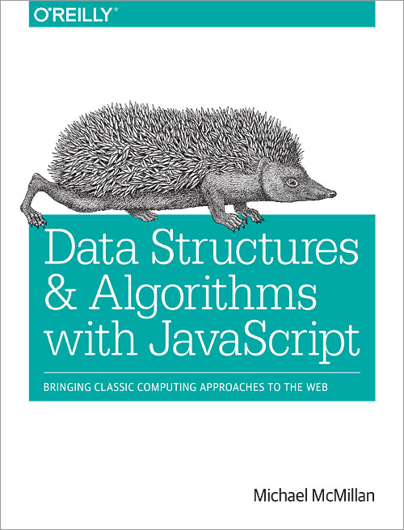
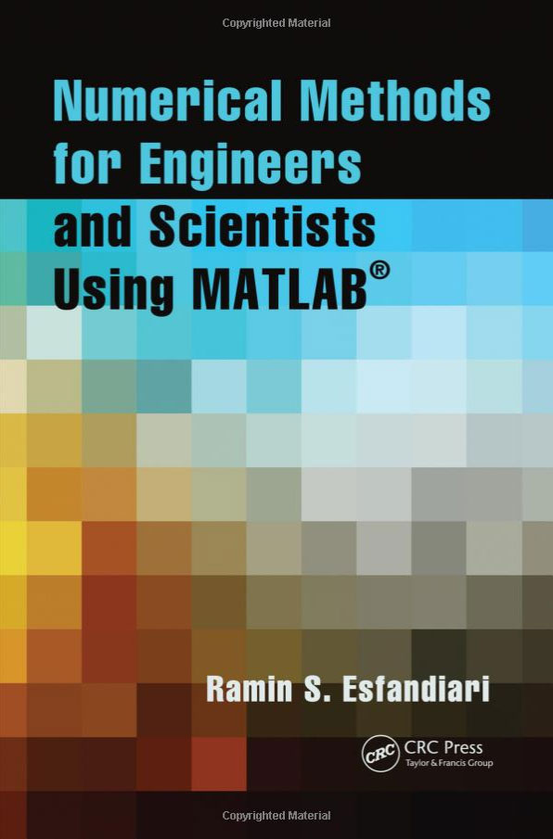
The Historical Approach

Slide 3
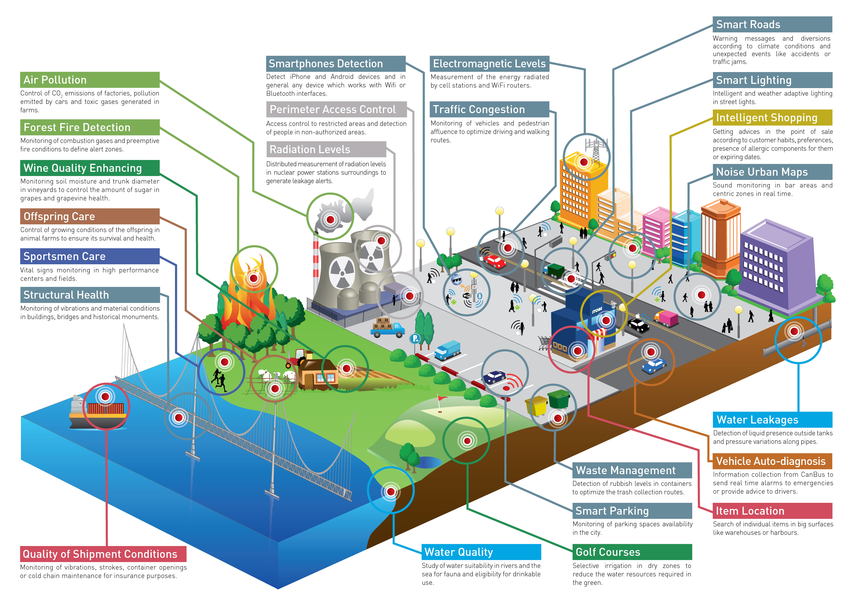
The Challenge: Complex Software Systems

Slide 4
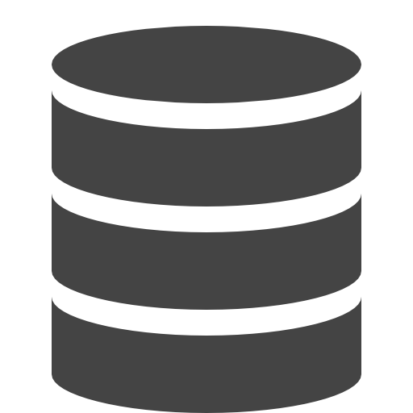
N Tiers Systems
CLIENT
SERVER
MIDDLEWARE
DATA STORE

Slide 5
System
Building Blocks

Slide 6
Application
Servers:
Small
Easy to use
Low Cost
Ubiquitous
Loosely Joined

Slide 7
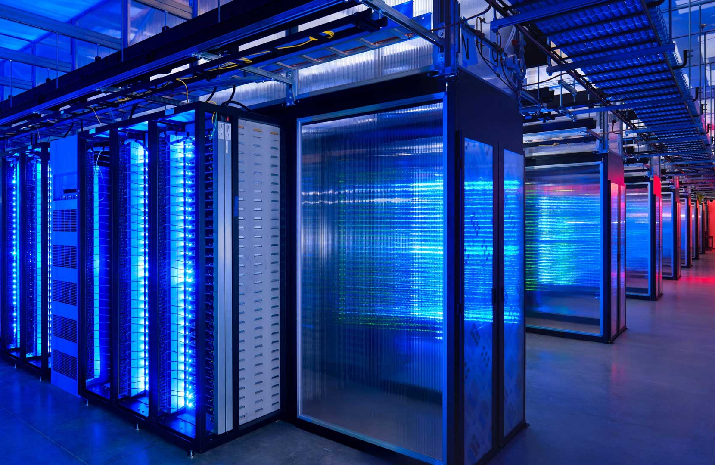
Application Server Skills
Service Creation
Service Consumption
Service Integration
Data Transformations
Concurrency
Coordination

Slide 8
Package Management
Registry
Creation
Distribution
Scalability

Slide 9
Parallel Happens – Async Programs
Non-Blocking
Event-loop
Callbacks
Promises

Slide 10
State Management
Record and Replay
Predictable Containers
Logging
Time Travel

Slide 11
Event Streams
Event Management
Event bubbling
Event Driven Programming
Reactive Patterns

Slide 12
Coordination
Orchestration
Integration
Error Handling

Slide 13
REST
Microservices
Route Mgmt.
Token Mgmt.
API Design

Slide 14
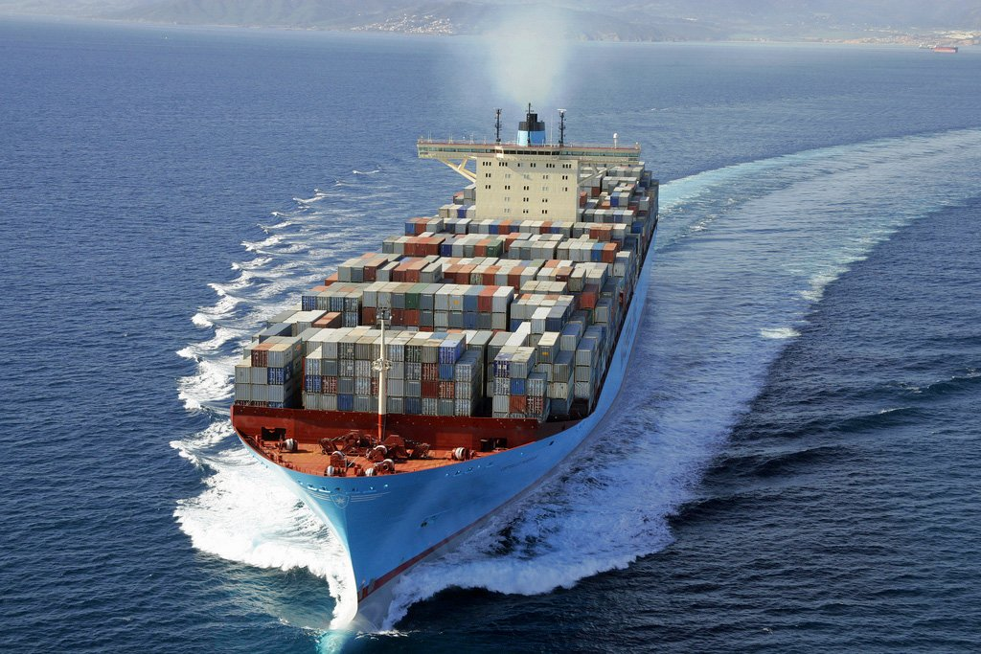
Containers
Container Mgmt.
Docker
Mesos
Kubernetes

Slide 15
Collaboration
Issues
Tracking
History
Notifications
Visualization
Patterns

Slide 16
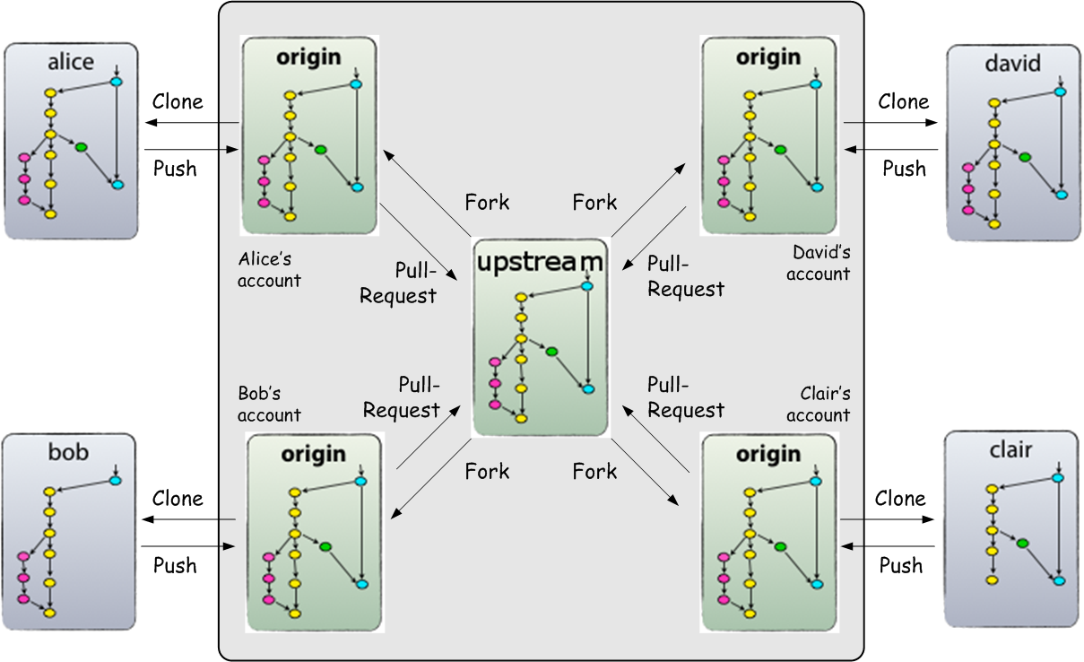
Collaboration

Slide 17
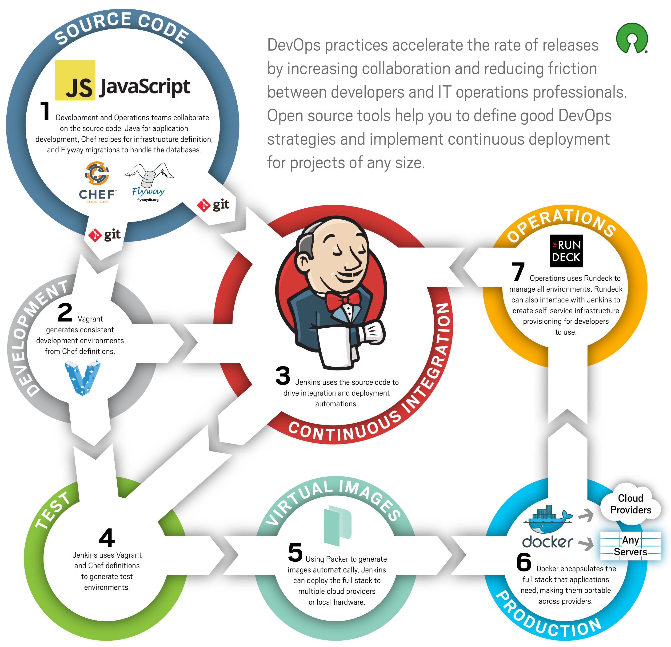
Continuous Integration

Slide 18
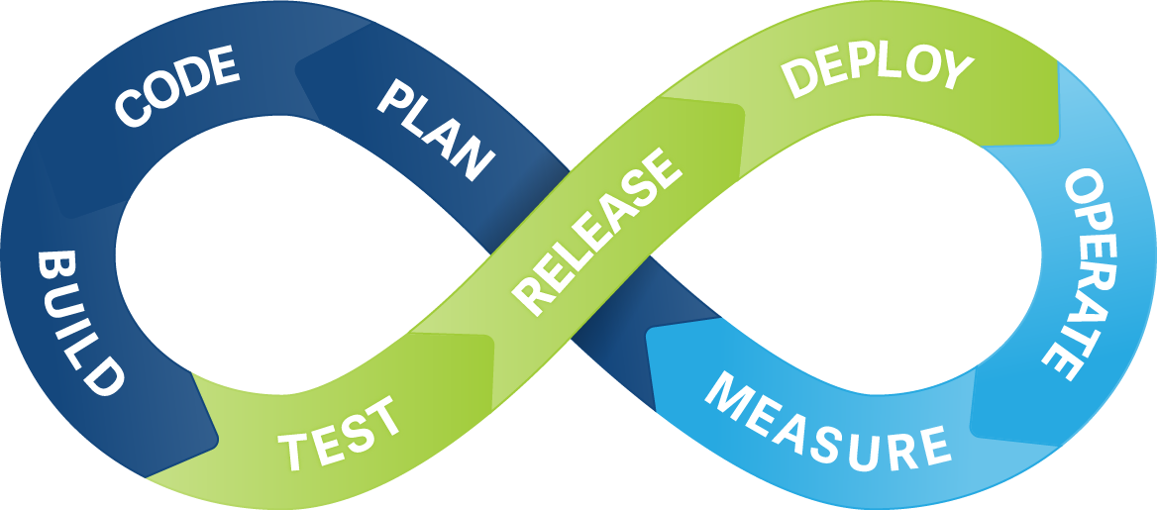
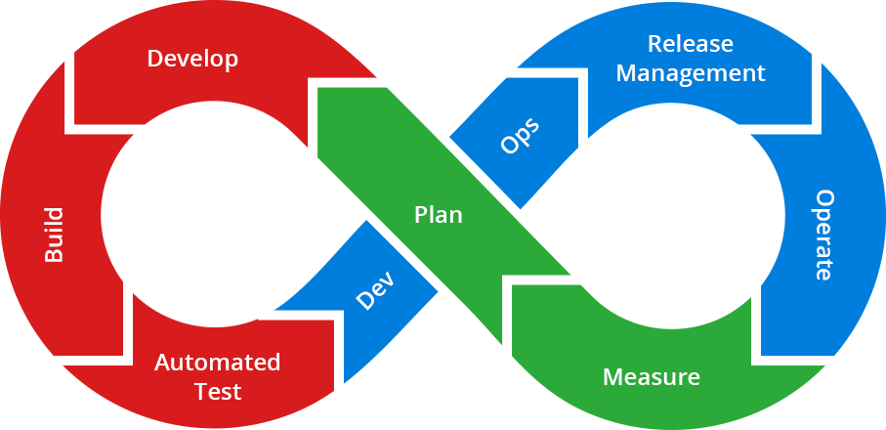
Continuous Integration

Slide 19
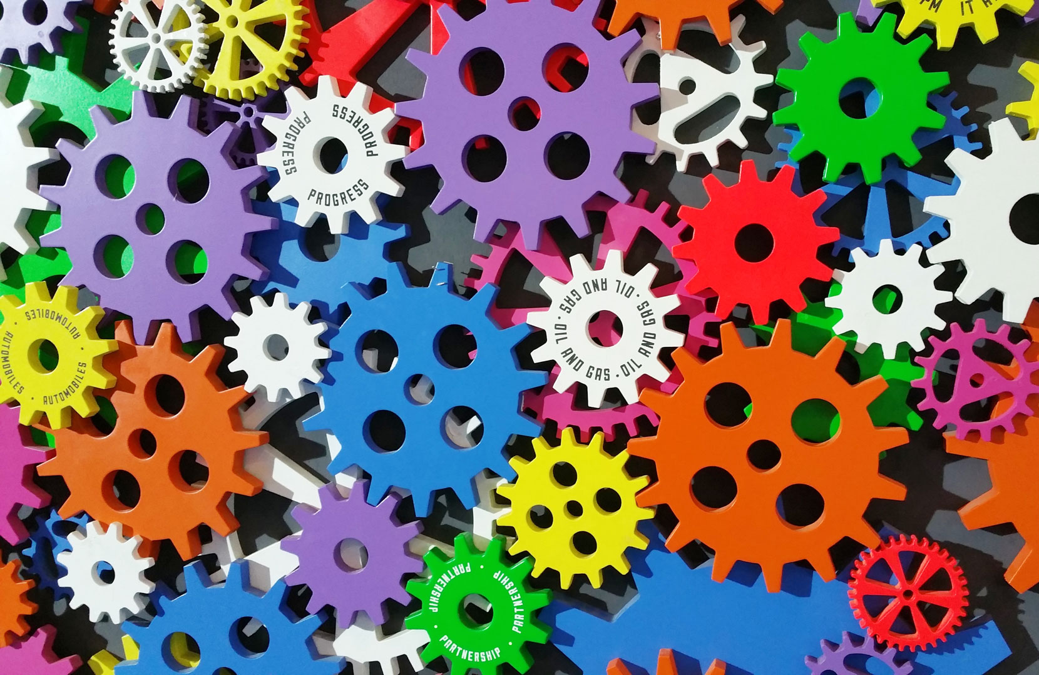
Continuous Integration
Pull Requests
Branch Select
Notification
Testing
Containers
Deployment

Slide 20
Big Data
Volume
Variety
Velocity
Transformations

Slide 21
Commodity Hardware
Low Cost
Easy to use
Runs Node
Many choices

Slide 22
Security
Identify
Protect
Detect
Respond
Recover

Slide 23
Technology

Slide 24
Open Source, Scalable, Large Adoption
CLIENT
SERVER
MIDDLEWARE
DATA STORE

Slide 25
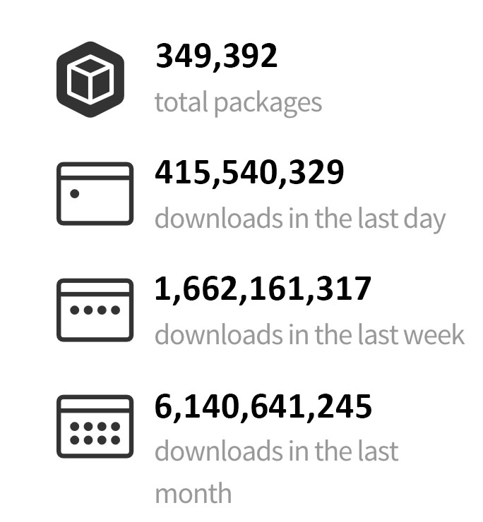
Some of the numbers

Slide 26
Construction
Cycle

Slide 27
Complex Software System Cycle
understand
the problem
learn
from test
architect
system
demo
system
build
system
test
system

Slide 28
Step 1: Understand the problem deeply

Slide 29
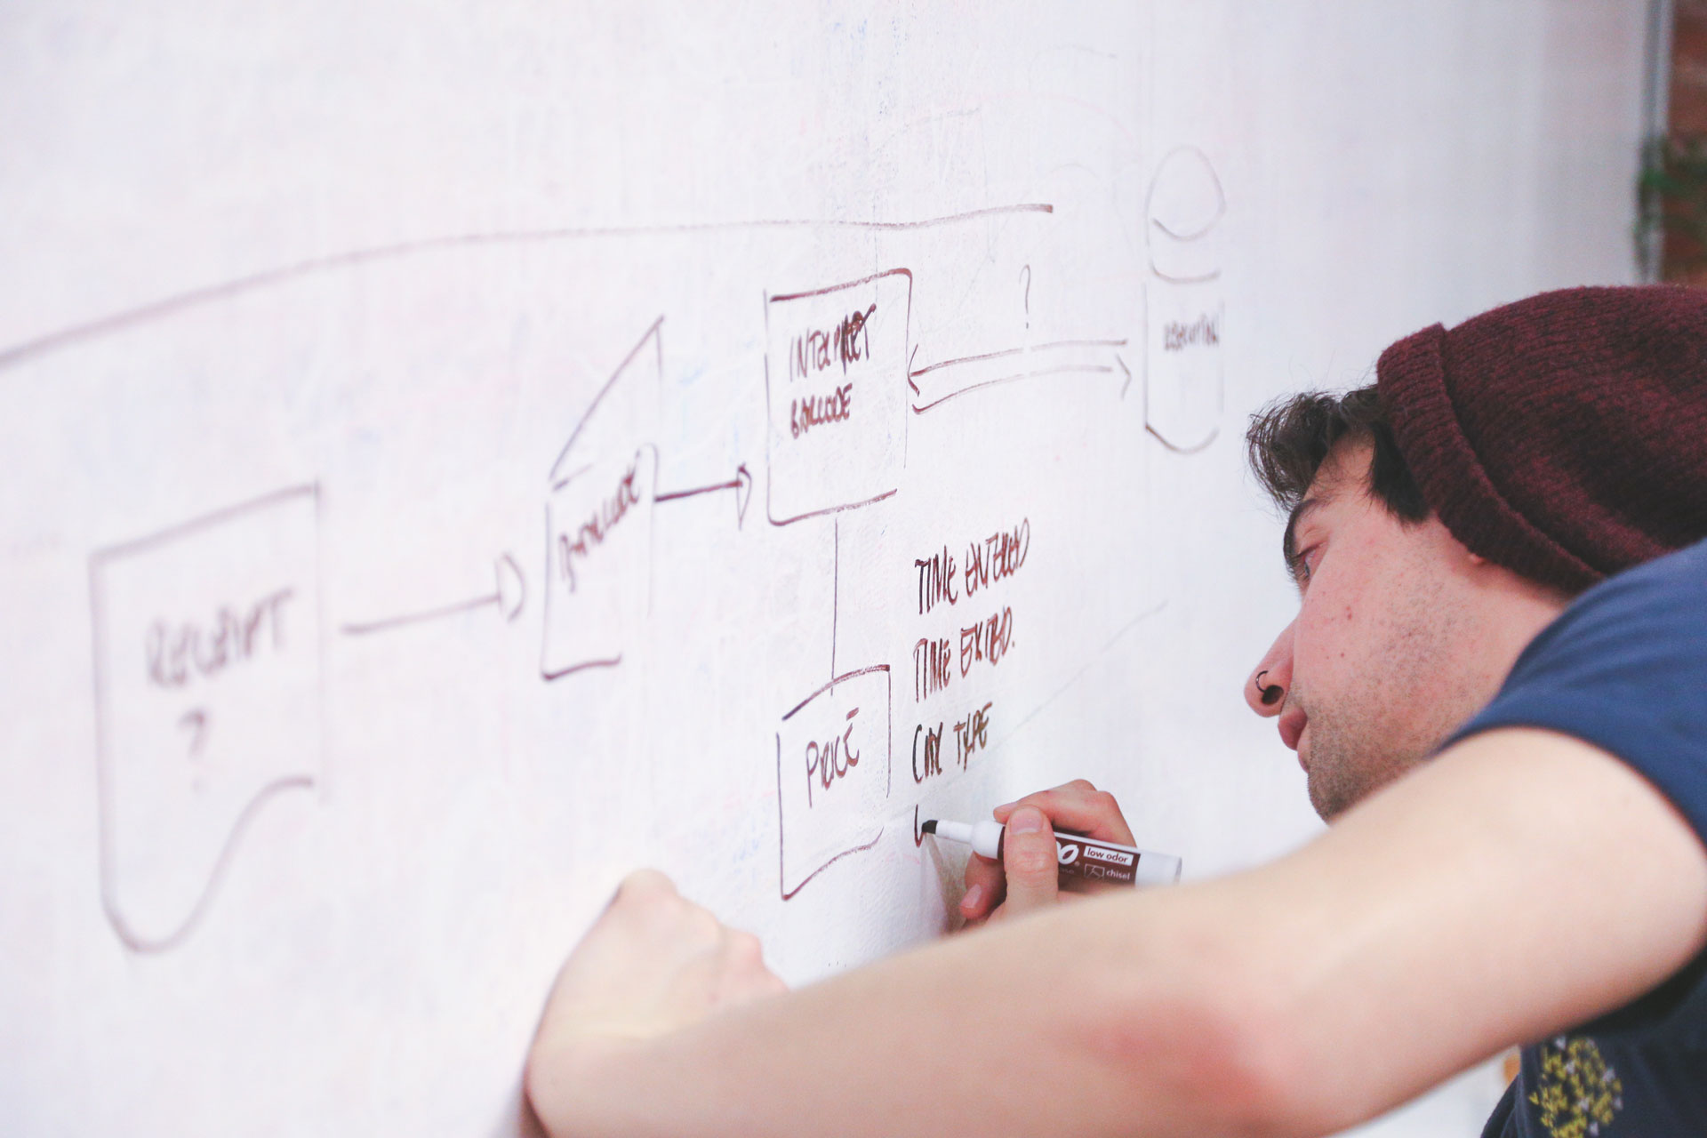
Step 2: Architect System

Slide 30
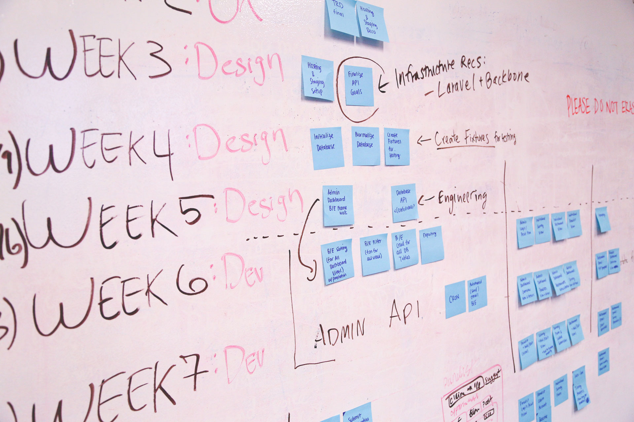
Step 3: Build System

Slide 31
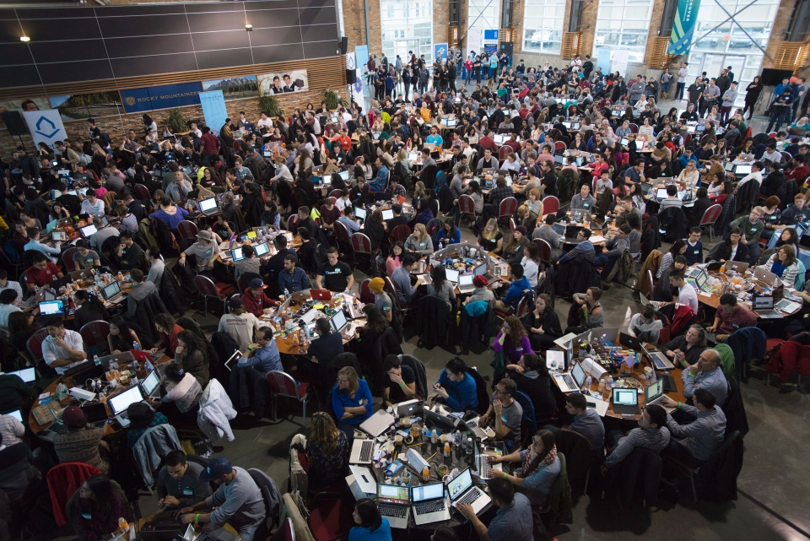
Step 4: Test the System

Slide 32
Step 5: Demo System

Slide 33
Step 6: Learn

Slide 34
Step 7: Iterate

