Slide 1
Services
Abel Sanchez, John R. Williams

Slide 3
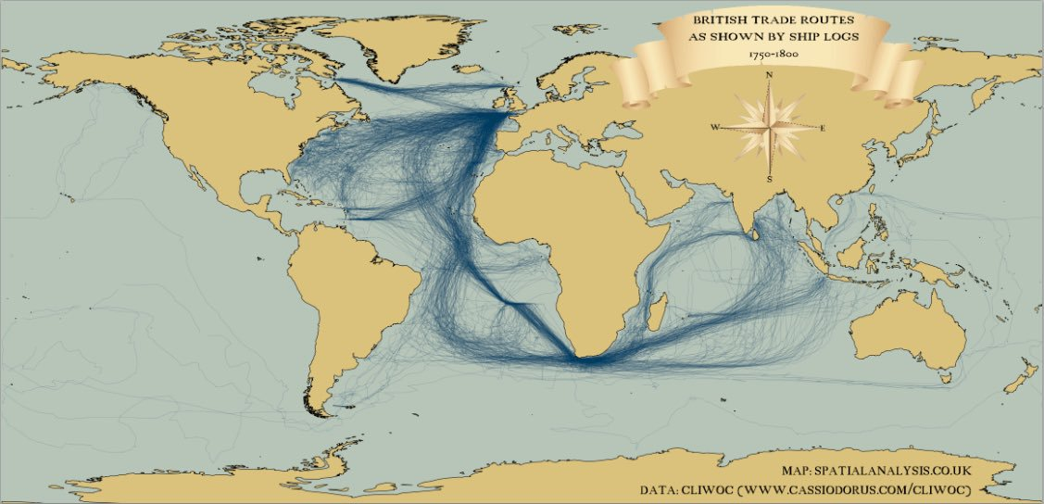
Work Requires Connections
Shipping Routes

Slide 4
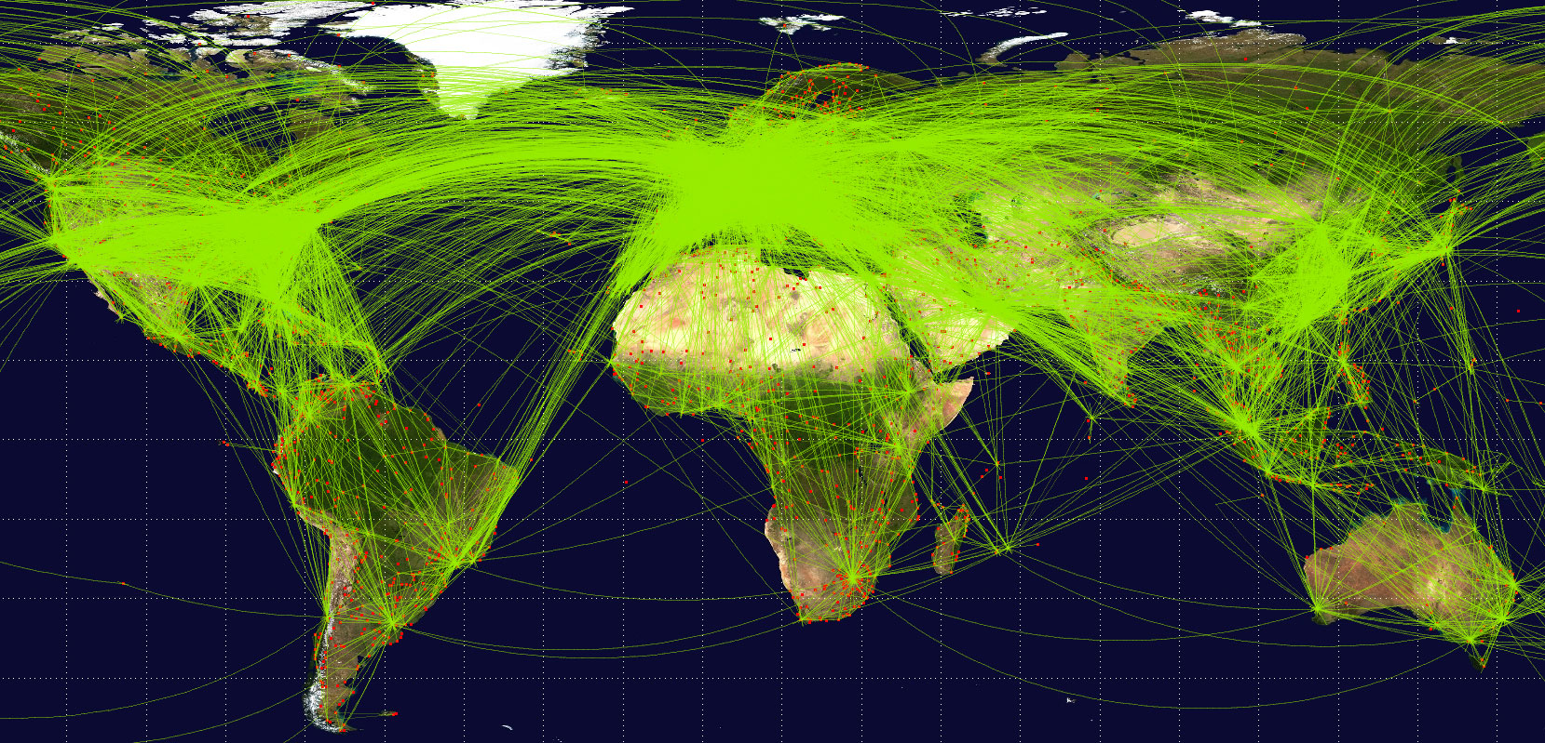
Work Requires Connections
Flight Routes

Slide 5
130 Trillion Pages
* Google, https://www.google.com/intl/bn/insidesearch/howsearchworks/thestory/

Slide 6
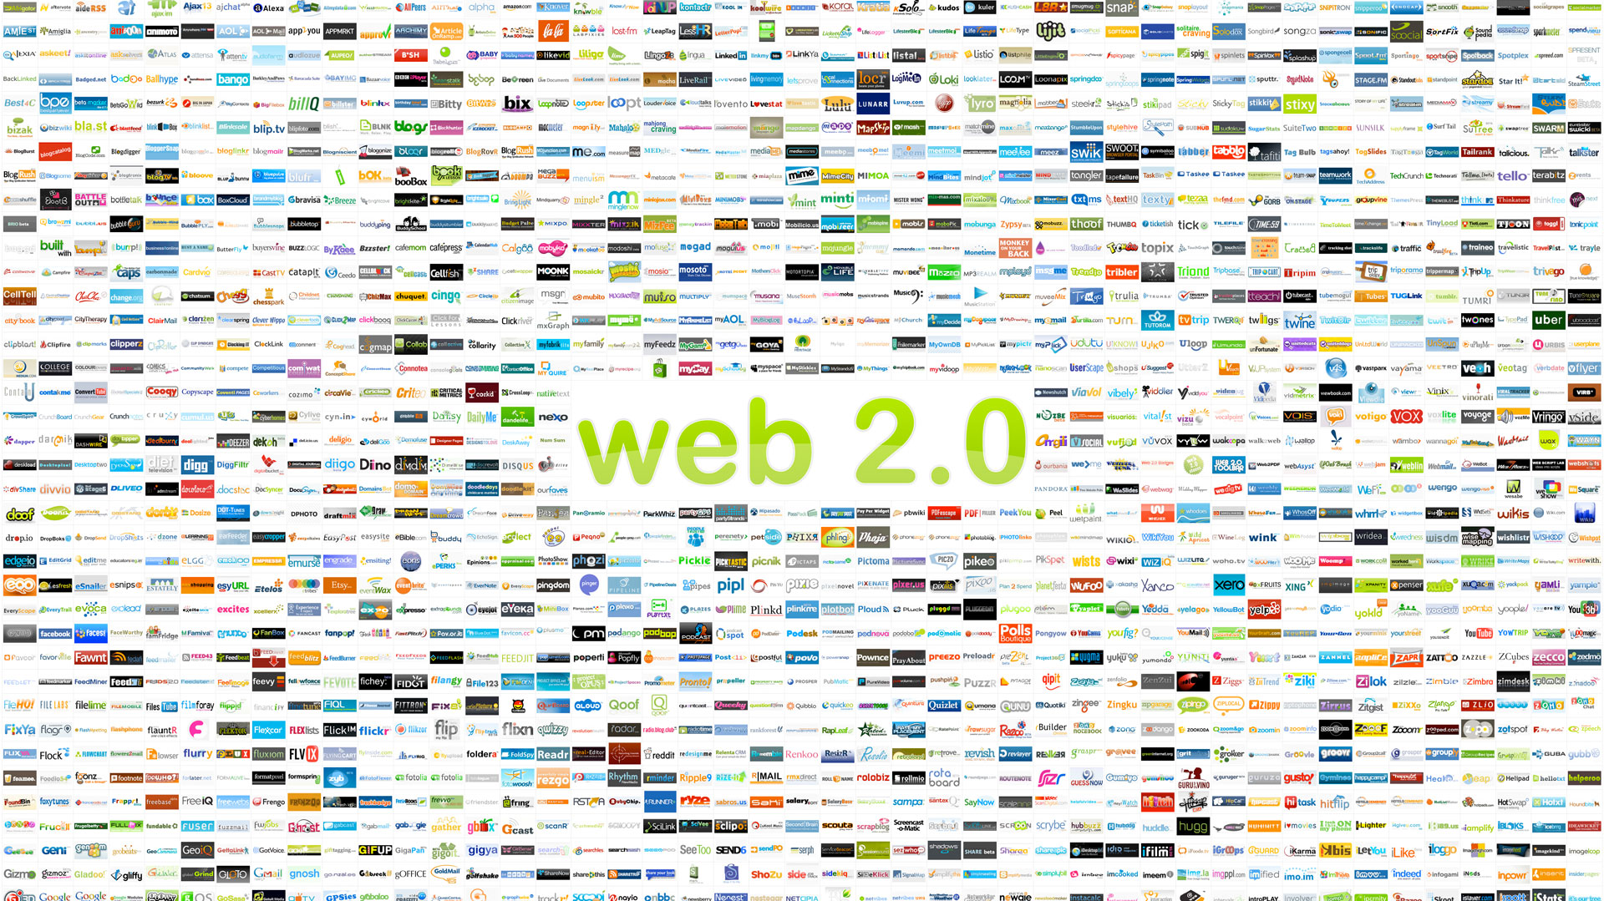

Slide 7
Connecting Physical to Virtual

Slide 8
Connecting Contract to Virtual

Slide 9
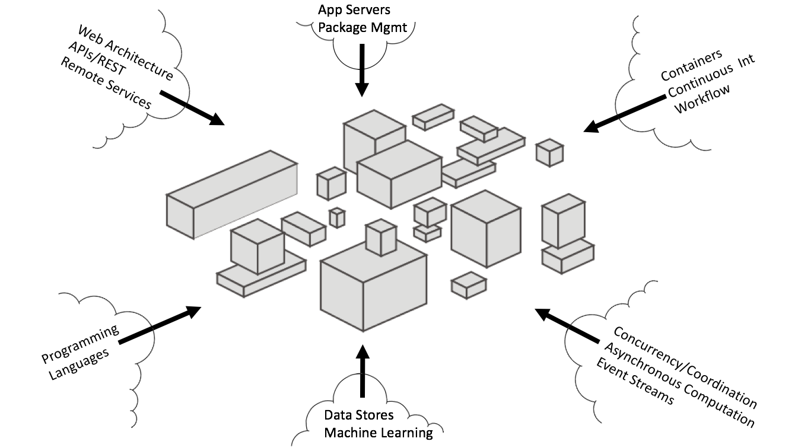

Slide 10
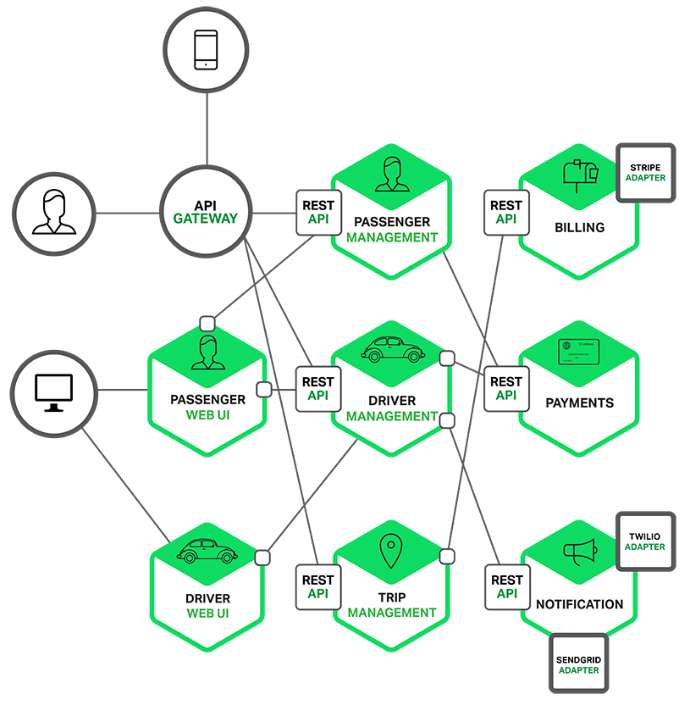
Services for
taxi-hailing
application

Slide 11
What about academia?

Slide 12
Traditional View of Scholarship
by
cites
Authors
Article
Articles

Slide 13
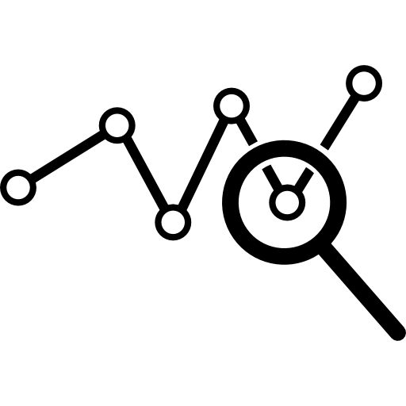
Today
output of
Datacenter
by
Code
Developer
by
used
used
Authors
Dataset
From
cites
by
cites
Article
used
organization
Big Data
Articles
Software Services
Web Pages

Slide 14
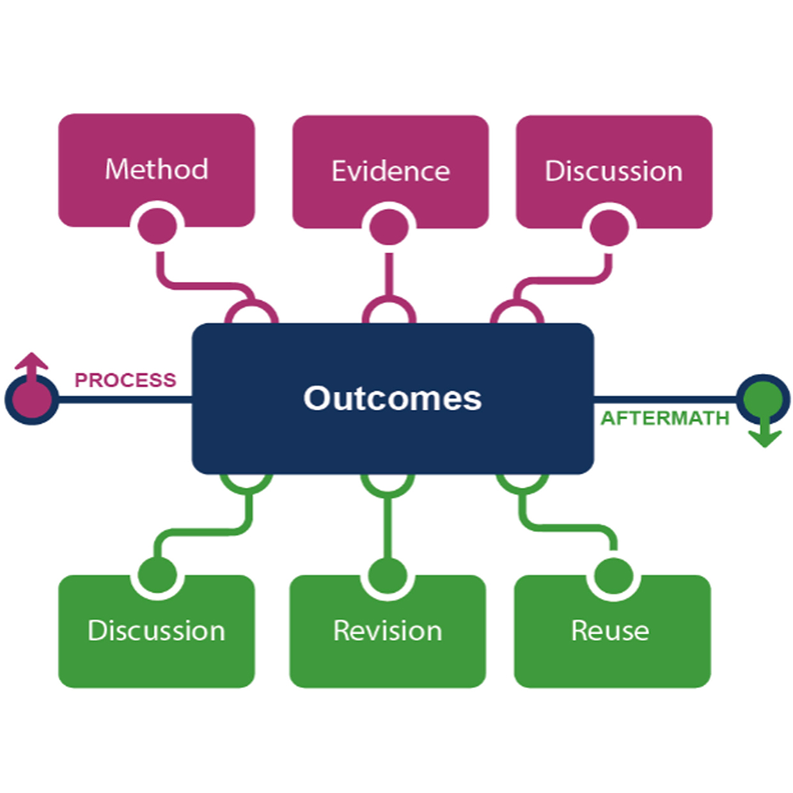
The work continues to evolve
Lavoie, Brian et al. 2014. The Evolving Scholarly Record. Dublin, Ohio: OCLC Research

Slide 15
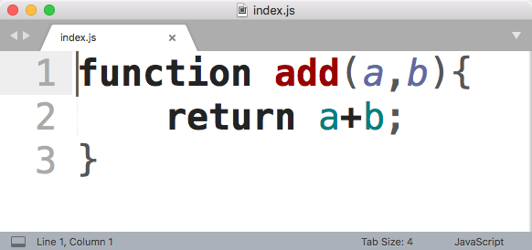
The Sharing Problem
How do I allow Bob to run my add function?
Alice’s Laptop
Alice
Bob

Slide 17
Services

Slide 18
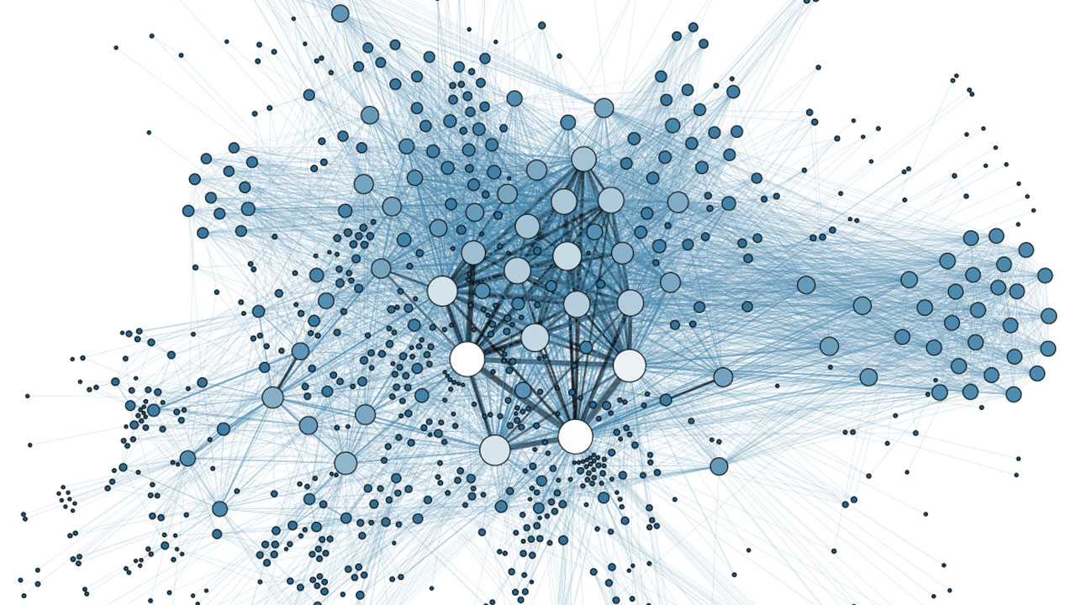
Node’s goal is to provide an easy way to build scalable network programs

Slide 19
Architectural Shift
1.old) web server with some application logic
1.new) app that can connect and collaborate
2.old) stateful
2.new) stateless

Slide 20
Architectural Shift
1.old) blocking
1.new) non-blocking
2.old) process per request
2.new) single process

Slide 21
MODULES

Slide 22
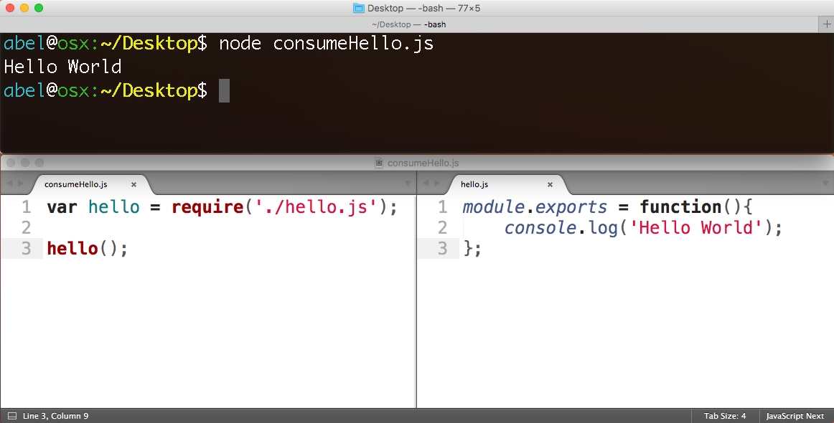
Use module with
“require”
Make module with “module.exports”

Slide 23
What is npm?
https://www.npmjs.com
Package manager. Installs, publishes and manages node programs

Slide 24
What is npm?
Billion+
downloads per month

Slide 25
What is a Module?
A Module is some JavaScript paired with a package.json file
+

Slide 26
Advantages
Small pieces, loosely joined
Leverage external packages
Leverage internal packages
Facilitate collaboration
Packages are discoverable in npm

Slide 27
Creating node/npm apps

Slide 28
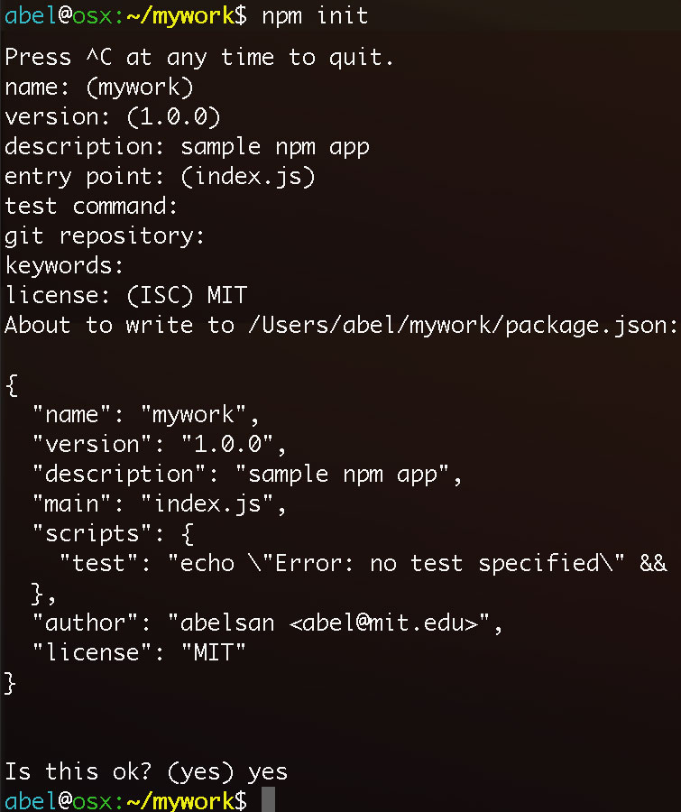
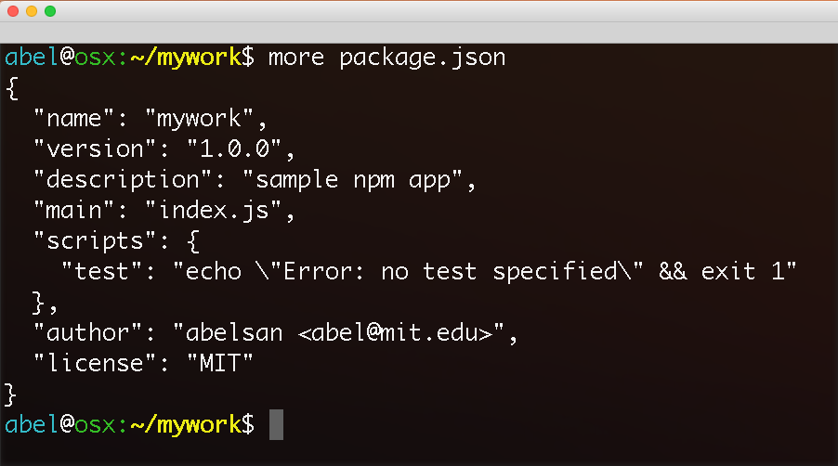
“npm init” generates the configuration file package.json

Slide 29
adding npm packages
to your application

Slide 30
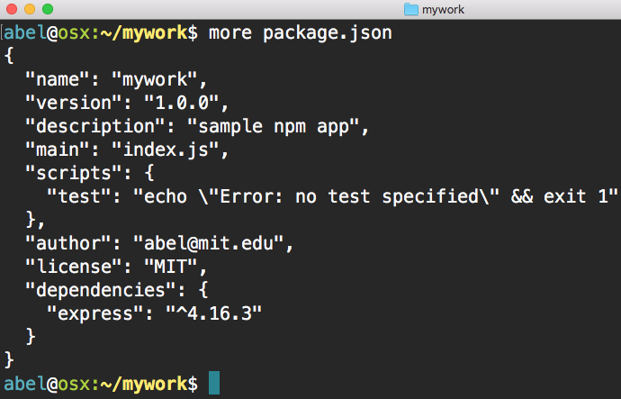
Local installation of express package. Dependency added to package.json

Slide 31
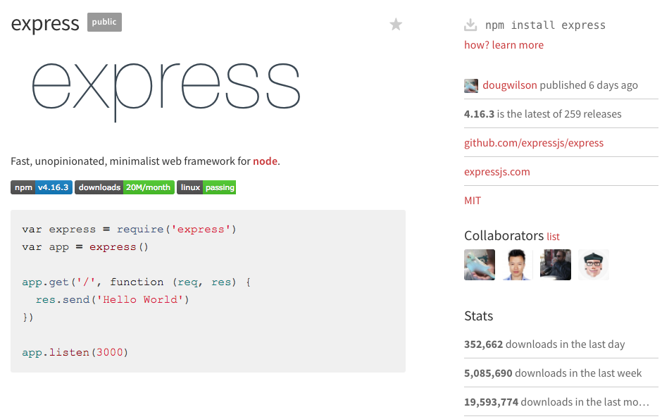

Slide 32
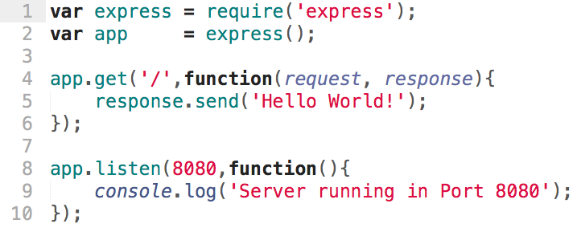
Hello World Server

Slide 33
Active Learning 1
Write a server that returns the current time
new Date()

Slide 34
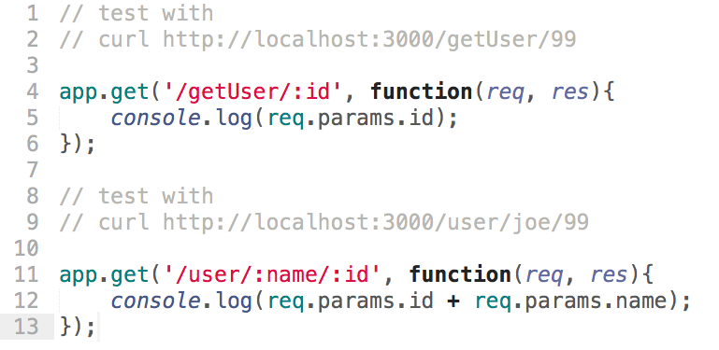
Pass Parameters Using Wildcards

Slide 35
Active Learning 2
app.get('/getUser/:id', function(req, res){
// --------------------------------------
// Your Code
// Return id to client
// --------------------------------------
});
app.get('/user/:name/:id', function(req, res){
// --------------------------------------
// Your Code
// Return id and name to client
// --------------------------------------
});

Slide 36
Active Learning 3
Building on Active Learning 2, return user based on ”id”. Use the following data.
var users = [
{ id : '01', name: 'john', email: 'john@mit.edu'},
{ id : '02', name: 'mary', email: 'mary@mit.edu'},
{ id : '03', name: 'paul', email: 'paul@mit.edu'},
{ id : '04', name: 'anna', email: 'anna@mit.edu'},
];

Slide 37
Active Learning 4
Building on Active Learning 3, add a route to add users. Calls should add new user and return the full users array.
app.get('/addUser/:id/:name/:email', function(req, res){
// --------------------------------------
// Your Code
// --------------------------------------
});

Slide 38
URL Query String
parameter
name
property
value
URL
http://www.site.com/page.html?parameter1=value1&parameter2=value2
Query
String
Begin
Query
String
Separator
Equal
Sign

Slide 39
Pass Parameters Using Query String
localhost:3000?name=abby&age=5&nickname=funny
var queryString = req.query;
console.log(queryString);
var age = req.query.age;
console.log(age);

Slide 40
Active Learning 5
Write a server route to extract URL query string parameters
app.get('/', function(req, res){
// --------------------------------------
// Your Code
// --------------------------------------
});

Slide 41
HTTP
POST
var express = require('express');
var app = express();
app.use(express.static('public'));
// used for form submissions
var bodyParser = require('body-parser');
app.use(bodyParser.json());
app.use(bodyParser.urlencoded());
/* GET Registration Page */
app.get('/', function(req, res){
res.redirect('/signup.html');
});
/* Handle Registration POST -
body-parser needed to parse form */
app.post('/signup', function(req, res){
var message = {
"username" : req.body.username,
"password" : req.body.password
};
console.log(req.body);
res.send(message);
});
app.listen(3000);

Slide 42
HTML
<!DOCTYPE html>
<html>
<form action="/signup" method="POST" >
Username:<br>
<input type="text" name="username"><br>
Password:<br>
<input type="text" name="password"><br>
<button type="submit">Submit</button>
</form>
</html>

Slide 43
Active Learning 5
Setup server

Slide 44
Publish npm module

Slide 45
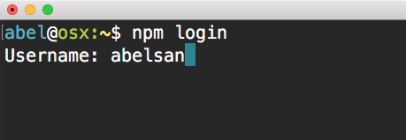
First login to npm

Slide 46
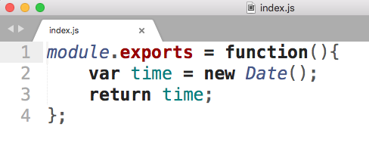
Write module
* Do not forget to add configuration data – npm init

Slide 47
Then publish

Slide 48
Q&A

Slide 49
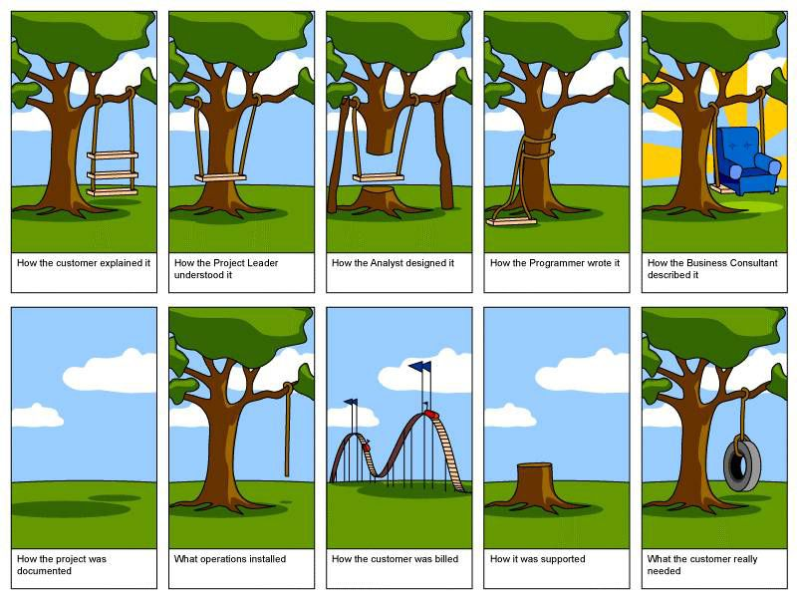
Software Development
Cycle

